Slide 1





BATHO HEALTHCARE
Your Health Our Responsibility
Home
About Us
Contact
Sign Up
Login
When the user clicks it will take him to home page
This will take the user to a page that consist of our information
This is for emergency
We Know Health Is Wealth
That’s Why We Obligated Our Selves To Keep You Alife
More Info
Batho Healthcare Info
Bathohealthcare@gmail.com
www.bathohealthcare.ac.za
+31 156 7789
Emergency Contact: +51 456 7786
@All Right Reserved by MMNK DEVELOPERS
@All Right Reserved by MMNK DEVELOPERS

Slide 2



BATHO HEALTHCARE
Your Health is our Responsibility
Back
As employees of Batho Hospital , we pledge to provide compassionate care, strive for excellence act with integrity , respect diversity, ensure safety and support our community
Our Core Values
Compassionate Care
Excellence in care
We treat every patient with kindness and respect, focusing on their individual and well-being
We deliver top quality medical care by staying up to date with practices and technology
Batho Healthcare Info
Bathohealthcare@gmail.com
www.bathohealthcare.ac.za
+31 156 7789
Emergency Contact: +51 456 7786
@All Right Reserved by MMNK DEVELOPERS

Slide 3
BATHO HEALTHCARE
Your Health Our Responsibility
Home
About Us
Contact
Sign Up
Login
We Know Health Is Wealth
That’s Why We Obligated Our Selves To Keep You Alife
More Info
Batho Healthcare Info
Bathohealthcare@gmail.com
www.bathohealthcare.ac.za
+31 156 7789
Emergency Contact: +51 456 7786
@All Right Reserved by MMNK DEVELOPERS

Slide 4
Sign Up
* All fields should be filled
Email Address
*
Sign Up
Already have an account? Login
Confirm Email Address
*
Password
*
Confirm Password
*
Batho Healthcare Info
Bathohealthcare@gmail.com
www.bathohealthcare.ac.za
+31 156 7789
Emergency Contact: +51 456 7786
@All Right Reserved by MMNK DEVELOPERS

Slide 5
Sign Up
* All field should be filled
Please enter email
*
Sign Up
Already have an account? Login
Please confirm email
*
Please enter Password
*
Please confirm Password
*
Batho Healthcare Info
Bathohealthcare@gmail.com
www.bathohealthcare.ac.za
+31 156 7789
Emergency Contact: +51 456 7786
@All Right Reserved by MMNK DEVELOPERS

Slide 6
Sign Up
* All field should be filled
ntshuxekoyvonne@gmail.com
*
Sign Up
Already have an account? Login
ntshuxekoyvonne@gmail.com
*
Yvonne@2
*
Yvonne@2
*
Batho Healthcare Info
Bathohealthcare@gmail.com
www.bathohealthcare.ac.za
+31 156 7789
Emergency Contact: +51 456 7786
@All Right Reserved by MMNK DEVELOPERS

Slide 7




LOGIN
Username
ntshuxekoyvonne@gmail.com
Password
********
Show
Forgot password?
Login
Batho Healthcare Info
Bathohealthcare@gmail.com
www.bathohealthcare.ac.za
+31 156 7789
Emergency Contact: +51 456 7786
@All Right Reserved by MMNK DEVELOPERS

Slide 8
Batho Healthcare Info
Bathohealthcare@gmail.com
www.bathohealthcare.ac.za
+31 156 7789
Emergency Contact: +51 456 7786

Slide 9
LOGIN
Wrong credentials
Invalid login
Username
ntshuxekoyvonne@gmail.com
*
Password
********
*
Show
The password must be in the following format
Forgot password?
Start with Uppercase
Maximum 8 characters
No special characters
Login
Batho Healthcare Info
Bathohealthcare@gmail.com
www.bathohealthcare.ac.za
+31 156 7789
Emergency Contact: +51 456 7786
@All Right Reserved by MMNK DEVELOPERS

Slide 10
LOGIN
Wrong credentials
Invalid login
Username
ntshuxekoyvonne@gmail.com
*
Password
/
Yvonne@2
*
Hide
The password must be in the following format
Forgot password?
Start with Uppercase
Maximum 8 characters
No special characters
Login
Batho Healthcare Info
Bathohealthcare@gmail.com
www.bathohealthcare.ac.za
+31 156 7789
Emergency Contact: +51 456 7786
@All Right Reserved by MMNK DEVELOPERS

Slide 11
LOGIN
Username
ntshuxekoyvonne@gmail.com
*
Password
Yvonne22
/
*
Hide
Forgot password?
Login
Batho Healthcare Info
Bathohealthcare@gmail.com
www.bathohealthcare.ac.za
+31 156 7789
Emergency Contact: +51 456 7786
@All Right Reserved by MMNK DEVELOPERS

Slide 12
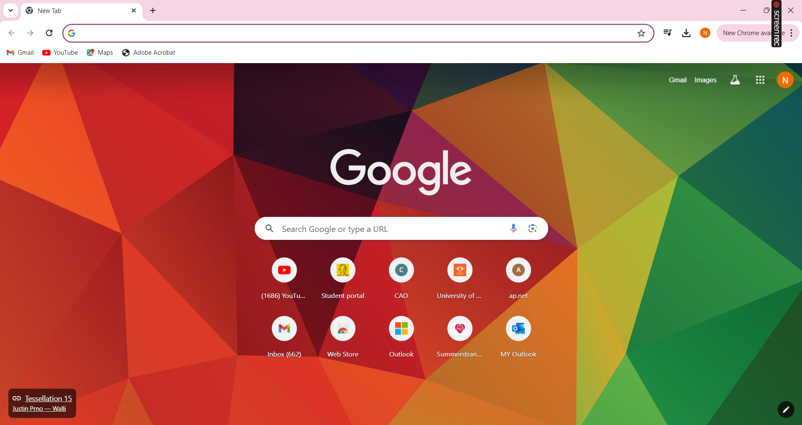








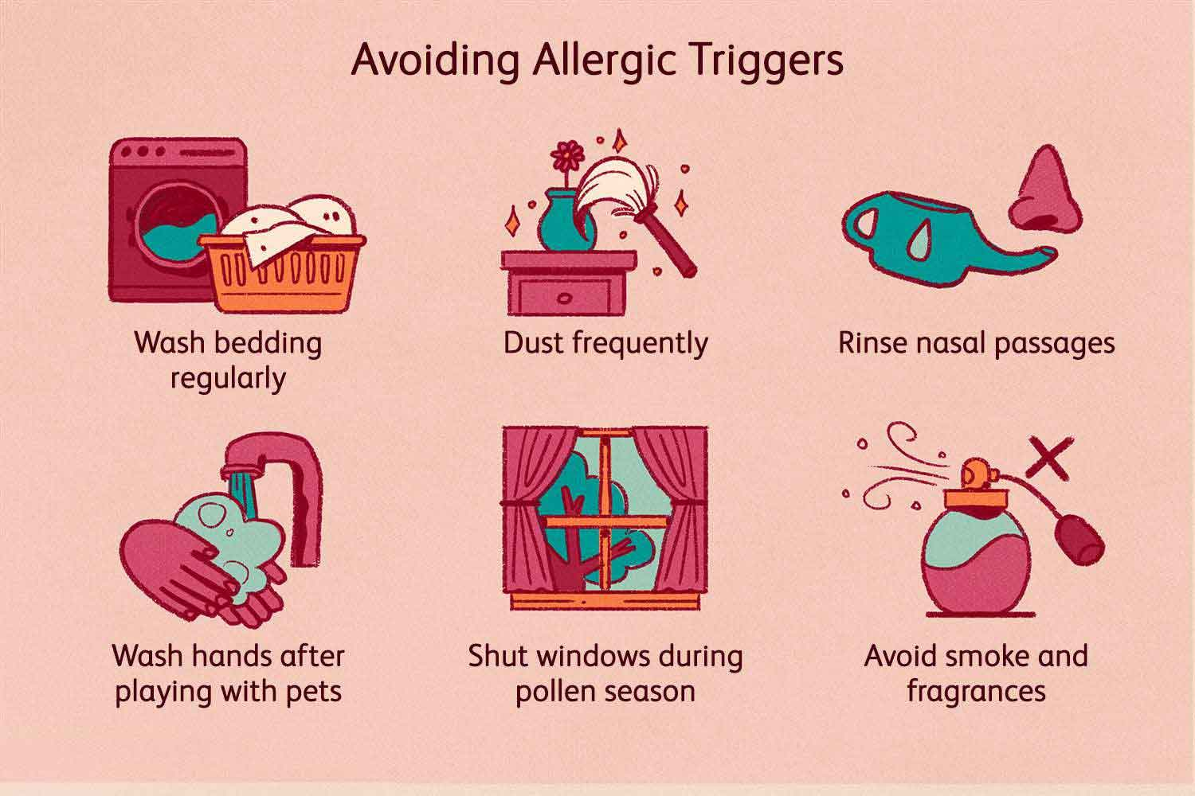

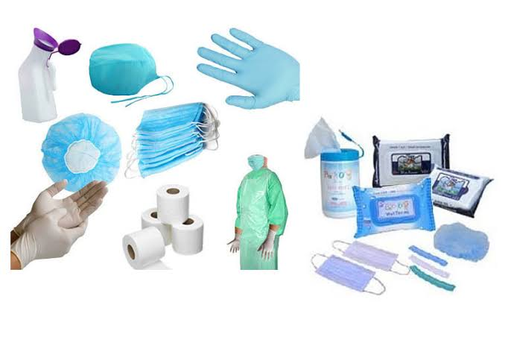


Batho Healthcare
Search..
Welcome
Admin N Yvonne
Home Dashboard My Schedule
Manage Employees
Manage Beds
Manage Conditions
Manage Allergies
Manage Hospital
Manage Consumable
Manage Medication
Batho Healthcare Info
Bathohealthcare@gmail.com
www.bathohealthcare.ac.za
+31 156 7789
Emergency Contact: +51 456 7786
@All Right Reserved by MMNK DEVELOPERS

Slide 13
BATHO HEALTHCARE
Your Health Our Responsibility
Home
About Us
Contact
Sign Up
Login
We Know Health Is Wealth
That’s Why We Obligated Our Selves To Keep You Alife
More Info
Batho Healthcare Info
Bathohealthcare@gmail.com
www.bathohealthcare.ac.za
+31 156 7789
Emergency Contact: +51 456 7786
@All Right Reserved by MMNK DEVELOPERS

Slide 14
Batho Healthcare
Search..
Welcome
Admin N Yvonne
Home Dashboard My Schedule
Manage Employees
Manage Beds
Manage Conditions
Manage Allergies
Manage Hospital
Manage Consumable
Manage Medication
Batho Healthcare Info
Bathohealthcare@gmail.com
www.bathohealthcare.ac.za
+31 156 7789
Emergency Contact: +51 456 7786
@All Right Reserved by MMNK DEVELOPERS

Slide 15



Batho Healthcare
Search..
Welcome
Admin N Yvonne
MANAGING EMPLOYEES
* All field should be filled
First Name:
John
*
Save
Middle Name:
(Optional)
Last Name:
McCarthy
*
Identity No:
9112123457890
*
Gender:
*
Date of Birth:
*
Physical Address:
*
Email Address:
*
Contact No:
*
Specialisation:
*

Slide 16
Batho Healthcare
Search..
Welcome
Admin N Yvonne
MANAGING EMPLOYEES
First Name:
John
Save
Middle Name:
Last Name:
McCarthy
Identity No:
9112123457890
Gender:
Male
Date of Birth:
Female
Physical Address:
Email Address:
Contact No:
Specialisation:

Slide 17
Batho Healthcare
Search..
Welcome
Admin N Yvonne
MANAGING EMPLOYEES
First Name:
John
Save
Middle Name:
Last Name:
McCarthy
Identity No:
9112123457890
Gender:
Male
Date of Birth:
< |  |  |  |  |  | >
Mo | Tu | We | Th | Fr | Su | Sa
30 | 1 | 2 | 3 | 4 | 5 | 6
7 | 8 | 9 | 10 | 11 | 12 | 13
14 | 15 | 16 | 17 | 18 | 19 | 20
21 | 22 | 23 | 24 | 25 | 26 | 27
28 | 29 | 30 | 31 | 1 | 2 | 3
Dec
1991
Physical Address:
Email Address:
Contact No:
Specialisation:

Slide 18
Batho Healthcare
Search..
Welcome
Admin N Yvonne
MANAGING EMPLOYEES
First Name:
John
Save
Middle Name:
Last Name:
McCarthy
Identity No:
9112123457890
Gender:
Male
Date of Birth:
12 December 1991
Physical Address:
Port Elizabeth
Summerstrand
Email Address:
j@gmail.com
Contact No:
071 111 1455
Specialisation:
Doctor

Slide 19


Batho Healthcare
Search..
Welcome
Admin N Yvonne
DISPLAY EMPLOYEES
Search
Print
Employee Name | Identity No | Date Of Birth | Gender | Physical Address | Email | Contact | Specialisation | Status
Ntshuxeko Yvonne | 8907119876546 | 1989-07-11 | Female | Betheldorp | ny@gmail.com | 082 555 8896 | Admin | Active
Noma Kubheka | 7506097654389 | 1975-06-09 | Female | Kwazul Natal | noma@gmail.com | 066 456 7654 | Nurse | Active
Noka Gumede | 8807157895436 | 1988-07-15 | Female | Kwazul Natal | noka@gmail.com | 071 235 7786 | Nurse-Sister | Active
Rosa Mkhwanazi | 9908086789653 | 1999-08-08 | Female | Port Elizabeth | rm@gmail.com | 065 456 4367 | Script Manager | Active
John McCarthy | 9112123457890 | 1991-12-12 | Male | Port Elizabeth | j@gmail.com | 071 111 1455 | Doctor | Active
Batho Healthcare Info
Bathohealthcare@gmail.com
www.bathohealthcare.ac.za
+31 156 7789
Emergency Contact: +51 456 7786
@All Right Reserved by MMNK DEVELOPERS

Slide 20
Batho Healthcare
Search..
Welcome
Admin N Yvonne
Do you want to update employee’s status
DISPLAY EMPLOYEES
Yes
No
Search
Print
Employee Name | Identity No | Date Of Birth | Gender | Physical Address | Email | Contact | Specialisation | Status
Ntshuxeko Yvonne | 8907119876546 | 1989-07-11 | Female | Betheldorp | ny@gmail.com | 082 555 8896 | Admin | Active
Noma Kubheka | 7506097654389 | 1975-06-09 | Female | Kwazul Natal | noma@gmail.com | 066 456 7654 | Nurse | Active
Noka Gumede | 8807157895436 | 1988-07-15 | Female | Kwazul Natal | noka@gmail.com | 071 235 7786 | Nurse-Sister | Active
Rosa Mkhwanazi | 9908086789653 | 1999-08-08 | Female | Port Elizabeth | rm@gmail.com | 065 456 4367 | Script Manager | Active
John McCarthy | 9112123457890 | 1991-12-12 | Male | Port Elizabeth | j@gmail.com | 071 111 1455 | Doctor | Active
Batho Healthcare Info
Bathohealthcare@gmail.com
www.bathohealthcare.ac.za
+31 156 7789
Emergency Contact: +51 456 7786
@All Right Reserved by MMNK DEVELOPERS

Slide 21
Batho Healthcare
Search..
Welcome
Admin N Yvonne
DISPLAY EMPLOYEES
Print
Search
Employee Name | Identity No | Date Of Birth | Gender | Physical Address | Email | Contact | Specialisation | Status
Ntshuxeko Yvonne | 8907119876546 | 1989-07-11 | Female | Betheldorp | ny@gmail.com | 082 555 8896 | Admin | Active
Noma Kubheka | 7506097654389 | 1975-06-09 | Female | Kwazul Natal | noma@gmail.com | 066 456 7654 | Nurse | Active
Noka Gumede | 8807157895436 | 1988-07-15 | Female | Kwazul Natal | noka@gmail.com | 071 235 7786 | Nurse-Sister | Active
Rosa Mkhwanazi | 9908086789653 | 1999-08-08 | Female | Port Elizabeth | rm@gmail.com | 065 456 4367 | Script Manager | Active
John McCarthy | 9112123457890 | 1991-12-12 | Male | Port Elizabeth | j@gmail.com | 071 111 1455 | Doctor | In Active
Batho Healthcare Info
Bathohealthcare@gmail.com
www.bathohealthcare.ac.za
+31 156 7789
Emergency Contact: +51 456 7786
@All Right Reserved by MMNK DEVELOPERS

Slide 22


Batho Healthcare
Search..
Print
1 Page
Welcome
Admin N Yvonne
Admin N Yvonne
Destination
Save as PDF
Pages
All
Employee Name | Identity No | Date Of Birth | Gender | Physical Address | Email | Contact | Specialisation | Status
Ntshuxeko Yvonne | 8907119876546 | 1989-07-11 | Female | Betheldorp | ny@gmail.com | 082 555 8896 | Admin | Active
Noma Kubheka | 7506097654389 | 1975-06-09 | Female | Kwazul Natal | noma@gmail.com | 066 456 7654 | Nurse | Active
Noka Gumede | 8807157895436 | 1988-07-15 | Female | Kwazul Natal | noka@gmail.com | 071 235 7786 | Nurse-Sister | Active
Rosa Mkhwanazi | 9908086789653 | 1999-08-08 | Female | Port Elizabeth | rm@gmail.com | 065 456 4367 | Script Manager | Active
John McCarthy | 9112123457890 | 1991-12-12 | Male | Port Elizabeth | j@gmail.com | 071 111 1455 | Doctor | In Active
Layout
Portrait
More Settings
Save
Cancel
Batho Healthcare Info
Bathohealthcare@gmail.com
www.bathohealthcare.ac.za
+31 156 7789
Emergency Contact: +51 456 7786
@All Right Reserved by MMNK DEVELOPERS

Slide 23
Batho Healthcare
Search..
Welcome
Admin N Yvonne
Home Dashboard My Schedule
Manage Employees
Manage Beds
Manage Conditions
Manage Allergies
Manage Hospital
Manage Consumable
Manage Medication
Batho Healthcare Info
Bathohealthcare@gmail.com
www.bathohealthcare.ac.za
+31 156 7789
Emergency Contact: +51 456 7786
@All Right Reserved by MMNK DEVELOPERS

Slide 24



Batho Healthcare
Search..
Welcome
Admin N Yvonne
MANAGE BEDS
Occupied Beds
Free Beds
Need of Maintenance
08
08
5
PatientID | Room No | Ward No | Bed No | Patient Status
001 | C12 | 01 | 003 | Admitted
023 | C12 | 01 | 004 | Discharged
017 | D11 | 02 | 005 | Admitted
012 | C12 | 01 | 011 | Admitted
007 | D11 | 02 | 009 | Admitted
003 | D11 | 02 | 017 | Admitted
013 | E14 | 04 | 023 | Admitted
009 | C12 | 01 | 008 | Admitted
Batho Healthcare Info
Bathohealthcare@gmail.com
www.bathohealthcare.ac.za
+31 156 7789
Emergency Contact: +51 456 7786
@All Right Reserved by MMNK DEVELOPERS

Slide 25

Batho Healthcare
Search..
Welcome
Admin N Yvonne
ADMITTED PATIENT DETAILS
BATHO HEALTHCARE
Your Health Our Responsibility
Patient No
001
Ward C12 01
Names:
Rosemary
Last Name:
Dube
Reason of Admission:
Diabetes Mellites
Date Of Admission :
11 March 2024
Possible discharge date:
N/A
Referred Doctor:
John Mnisi
Transfer Patient:
--Select Ward--
--Select Bed--
Transfer
Batho Healthcare Info
Bathohealthcare@gmail.com
www.bathohealthcare.ac.za
+31 156 7789
Emergency Contact: +51 456 7786
@All Right Reserved by MMNK DEVELOPERS

Slide 26


Batho Healthcare
Search..
Welcome
Admin N Yvonne
MANAGE BEDS
Free Beds
08
TOTAL BEDS 21
Bed No 004
Room No D11
Bed No 004
Room No C12
Bed No 004
Room No C12
Bed No 004
Room No D11
Ward No 02
Ward No 01
Ward No 01
Ward No 02
Bed No 004
Room No E14
Bed No 004
Room No E14
Bed No 004
Room No D11
Bed No 004
Room No C12
Ward No 04
Ward No 04
Ward No 02
Ward No 01
Batho Healthcare Info
Bathohealthcare@gmail.com
www.bathohealthcare.ac.za
+31 156 7789
Emergency Contact: +51 456 7786
@All Right Reserved by MMNK DEVELOPERS

Slide 27
Batho Healthcare
Search..
Welcome
Admin N Yvonne
Home Dashboard My Schedule
Manage Employees
Manage Beds
Manage Conditions
Manage Allergies
Manage Hospital
Manage Consumable
Manage Medication
Batho Healthcare Info
Bathohealthcare@gmail.com
www.bathohealthcare.ac.za
+31 156 7789
Emergency Contact: +51 456 7786
@All Right Reserved by MMNK DEVELOPERS

Slide 28

Batho Healthcare
Search..
Welcome
Admin N Yvonne
MANAGE HOSPITAL
Hospital Name
Hospital Slogan
Hospital Address
Hospital Contact Details
Hospital logo
Upload a logo
Only PDF is allowed
UPDATE
Batho Healthcare Info
Bathohealthcare@gmail.com
www.bathohealthcare.ac.za
+31 156 7789
Emergency Contact: +51 456 7786
@All Right Reserved by MMNK DEVELOPERS

Slide 29
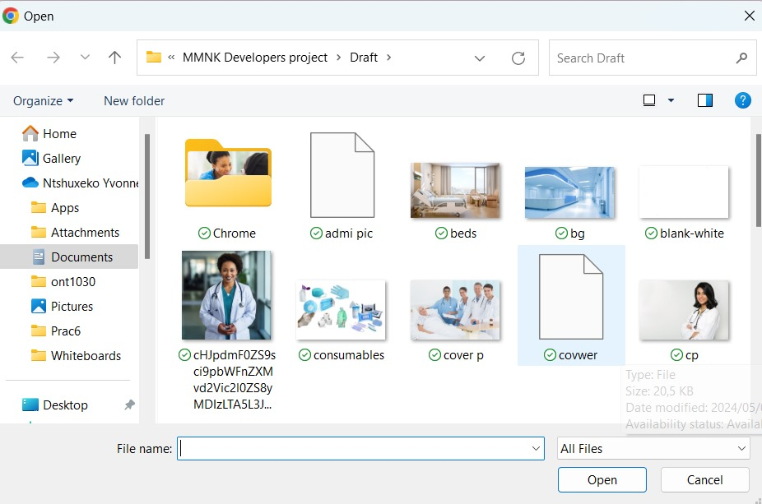
Batho Healthcare
Search..
Welcome
Admin N Yvonne
MANAGE HOSPITAL
Hospital Name
Hospital Slogan
Hospital Address
Hospital Contact Details
Hospital logo
Upload a logo
Only PDF is allowed
UPDATE
Batho Healthcare Info
Bathohealthcare@gmail.com
www.bathohealthcare.ac.za
+31 156 7789
Emergency Contact: +51 456 7786
@All Right Reserved by MMNK DEVELOPERS

Slide 30
Batho Healthcare
Search..
Welcome
Admin N Yvonne
Home Dashboard My Schedule
Manage Employees
Manage Beds
Manage Conditions
Manage Allergies
Manage Hospital
Manage Consumable
Manage Medication
Batho Healthcare Info
Bathohealthcare@gmail.com
www.bathohealthcare.ac.za
+31 156 7789
Emergency Contact: +51 456 7786
@All Right Reserved by MMNK DEVELOPERS

Slide 31

Batho Healthcare
Search..
Welcome
Admin N Yvonne
MANAGE CONDITIONS
Add
Update
Acute Condition | Chronic Disease | Infectious Diseases | End-of-life | Mental Health | Surgical Condition | Maternal and Neonal Condition | Chronic Pain Management
Heart Attach | Diabetes Mellitus | Influenza | Appendicitis | Depression | Pregnancy Compilation | Fibromyalgia | Pilliative Care
Pneumonia | High Blood Pressure | Tuberculosis | Cancer | Major Depressive Disorder | Appendicitis | Gestational Diabetes | Acetaminophen
Gastroenteritis | Coronary Artery Disease | Strep Throat | Advanced Heart Disease | Bipolar Disorder | Cholecystitis | Hyperemesis Gravidarum | Opioids
Fractures | Heart Failure | Bacterial Meningitis | Kidney Failure | Dysthymia | Hernias | Placenta Previa | Antidepressants
Batho Healthcare Info
Bathohealthcare@gmail.com
www.bathohealthcare.ac.za
+31 156 7789
Emergency Contact: +51 456 7786
@All Right Reserved by MMNK DEVELOPERS

Slide 32
Batho Healthcare
Search..
Welcome
Admin N Yvonne
Home Dashboard My Schedule
Manage Employees
Manage Beds
Manage Conditions
Manage Allergies
Manage Hospital
Manage Consumable
Manage Medication
Batho Healthcare Info
Bathohealthcare@gmail.com
www.bathohealthcare.ac.za
+31 156 7789
Emergency Contact: +51 456 7786
@All Right Reserved by MMNK DEVELOPERS

Slide 33
Batho Healthcare
Search..
Welcome
Admin N Yvonne
MANAGE ALLERGIES
Food Allergies | Environ | emtal Allergies | Insect Sting Allergies | Medical Allergies | Allergic Contact Dermatitis | Allergic Rhimitis(Hay Fever) | Exercise-Induced Allergies | Occupation Allergies
Peanuts | dust | Pollen | Bees | Penicillin | Cosmetics | Pollen | Exercise-induced anaphylaxis | Allergens form work settings
Milk | Mold
Eggs | Dust Mites
Tree Nuts | Pet Dander
Soy | Cockroach Droppings
Wheat | Tree Pollen
Batho Healthcare Info
Bathohealthcare@gmail.com
www.bathohealthcare.ac.za
+31 156 7789
Emergency Contact: +51 456 7786
@All Right Reserved by MMNK DEVELOPERS

Slide 34
Batho Healthcare
Search..
Welcome
Admin N Yvonne
Home Dashboard My Schedule
Manage Employees
Manage Beds
Manage Conditions
Manage Allergies
Manage Hospital
Manage Consumable
Manage Medication
Batho Healthcare Info
Bathohealthcare@gmail.com
www.bathohealthcare.ac.za
+31 156 7789
Emergency Contact: +51 456 7786
@All Right Reserved by MMNK DEVELOPERS

Slide 35
Batho Healthcare
Search..
Welcome
Admin N Yvonne
MANAGE MEDICATION
Analgesics(Pain Relievers) | Antibiotics | Antihistamine | Antacids | Antidepressants | Antidiabetic Medications | Anticoagulants
Aspirin | Penicillin | Cetirizine | Calcium Carbonate | Cymbalta | Metformin | Heparin
Batho Healthcare Info
Bathohealthcare@gmail.com
www.bathohealthcare.ac.za
+31 156 7789
Emergency Contact: +51 456 7786
@All Right Reserved by MMNK DEVELOPERS

Slide 36
Batho Healthcare
Search..
Welcome
Admin N Yvonne
Home Dashboard My Schedule
Manage Employees
Manage Beds
Manage Conditions
Manage Allergies
Manage Hospital
Manage Consumable
Manage Medication
Batho Healthcare Info
Bathohealthcare@gmail.com
www.bathohealthcare.ac.za
+31 156 7789
Emergency Contact: +51 456 7786
@All Right Reserved by MMNK DEVELOPERS

Slide 37
Batho Healthcare
Search..
Welcome
Admin N Yvonne
MANAGE CONSUMABLES
Consumable Name | Availability Status
Adhesive Bandages | Available
Sterile Gloves | Available
Syringes and Needles | Available
Alcohol Swabs | Available
Medical Type | Available
Disposable under pads | Available
Disposables Marks | Available
Disposables Gowns | Available
Disposable Caps and Shoe Covers | Available
Update
Batho Healthcare Info
Bathohealthcare@gmail.com
www.bathohealthcare.ac.za
+31 156 7789
Emergency Contact: +51 456 7786
@All Right Reserved by MMNK DEVELOPERS

Slide 38
Batho Healthcare
Search..
Welcome
Admin N Yvonne
DOCTOR REFFERAL
First Name
Last Name
Date of Birth
Gender
--Select --
Doctor Name
Contact No
Admission Date
Batho Healthcare Info
Bathohealthcare@gmail.com
www.bathohealthcare.ac.za
+31 156 7789
Emergency Contact: +51 456 7786
@All Right Reserved by MMNK DEVELOPERS

Slide 39

Batho Healthcare
Search..
Welcome
Admin N Yvonne
DOCTOR REFFERAL
First Name
Joseph
Last Name
Marry
Date of Birth
01 May 1996
Gender
Male
Doctor Name
Dr John Macathy
Contact No
(+27)76 888 9090
Admission Date
2 Dec 2024
Save
Display
Batho Healthcare Info
Bathohealthcare@gmail.com
www.bathohealthcare.ac.za
+31 156 7789
Emergency Contact: +51 456 7786
@All Right Reserved by MMNK DEVELOPERS

Slide 40
Batho Healthcare
Search..
Welcome
Admin N Yvonne
PATIENT REFFERAL
Patient Name | Date of Birth | Gender | Contact No | Doctor | Admission Date
John Marry | 01 May 1996 | Male | 076 888 9090 | John Mnisi | 02 Dec 2024
Grace Ndlovu | 02 June 1995 | Female | 079 366 0440 | John Mnisi | 07 June 2024
Melusi Nkosi | 07 August 1999 | Male | 066 272 3456 | John Mnisi | 08 July 2024
Batho Healthcare Info
Bathohealthcare@gmail.com
www.bathohealthcare.ac.za
+31 156 7789
Emergency Contact: +51 456 7786
@All Right Reserved by MMNK DEVELOPERS

Slide 41


Batho Healthcare
Welcome
Admin N Yvonne
Search..
CREATE PATIENT FOLDER
Personal Information
NEXT
Title:
Mr
*
Names:
*
Date of Birth:
01 May 1996
*
Identity No:
960501786
Must be13 Digits
No characters
Marital Status:
Married
Gender:
Male
*
Occupation:
Lawyer
*
Language:
Afrikaans
*
Batho Healthcare Info
Bathohealthcare@gmail.com
www.bathohealthcare.ac.za
+31 156 7789
Emergency Contact: +51 456 7786
@All Right Reserved by MMNK DEVELOPERS

Slide 42

Batho Healthcare
Search..
Welcome
Admin N Yvonne
NEXT
BACK
Address Details
Contact Information
Phone No:
078 888 9090
*
(071-38-38-963)
Address Line 1:
*
Address Line 2:
Email:
*
Stand no 56
*
jm@gmail.com
(name@gmail.com)
Suburb:
Summerstrand
*
City:
Port Elizabeth
*
Postal Code:
6001
*
Province:
Eastern Cape
*
Batho Healthcare Info
Bathohealthcare@gmail.com
www.bathohealthcare.ac.za
+31 156 7789
Emergency Contact: +51 456 7786
@All Right Reserved by MMNK DEVELOPERS

Slide 43
Batho Healthcare
Search..
Welcome
Admin N Yvonne
NEXT
BACK
Next Of Kin
First Name:
Mandlovu
*
Last Name:
Marry
*
*
Contact No:
(071-38-38-963)
*
Relationship:
Wife
*
Batho Healthcare Info
Bathohealthcare@gmail.com
www.bathohealthcare.ac.za
+31 156 7789
Emergency Contact: +51 456 7786
@All Right Reserved by MMNK DEVELOPERS

Slide 44
Batho Healthcare
Search..
Welcome
Admin N Yvonne
BACK
NEXT
Bed:
003DC
Bed Status:
Occupied
Allergies:
Peanuts
Chronic Conditions:
Diabetes
*
Yes
No
Unable to submit Please fill out all
Do you smoke?:
Admission Status:
Admitted
Submit
Batho Healthcare Info
Bathohealthcare@gmail.com
www.bathohealthcare.ac.za
+31 156 7789
Emergency Contact: +51 456 7786
@All Right Reserved by MMNK DEVELOPERS

Slide 45
Batho Healthcare
Search..
Welcome
Admin N Yvonne
VIEW PATIENT FILES
Search Patient File
Patient Name | ID No | Bed Allocation | Allergies | Chronic condition | Contact No | Emergency No | Admission Date | Admission Status
John Marry | 9605017863906 | 003DC | Allergic to peanuts | Diabetes Mellitus | 078 888 9090 | 078 167 8890 | 02 Dec 2024 | Admitted
Grace Ndlovu | 9506026534890 | 004DC | Allergic to milk | Tuberculosis | 079 366 0440 | 076 076 2830 | 07 June 2024 | Admitted
Melusi Nkosi | 9908075678534 | 002DC | Allergic cheese | High Blood | 066 272 3456 | 079 123 4044 | 08 July 2024 | Admitted
Batho Healthcare Info
Bathohealthcare@gmail.com
www.bathohealthcare.ac.za
+31 156 7789
Emergency Contact: +51 456 7786
@All Right Reserved by MMNK DEVELOPERS

Slide 46
LOGIN
Username
kubheka@gmail.com
Password
********
Show
Forgot password?
Login
Batho Healthcare Info
Bathohealthcare@gmail.com
www.bathohealthcare.ac.za
+31 156 7789
Emergency Contact: +51 456 7786
@All Right Reserved by MMNK DEVELOPERS

Slide 47

Batho Healthcare
Search..
Welcome
Nurse Kubheka
Home Dashboard My Schedule
Administer no-schedule Med
Contact Doctor
Record Patient’s Vitals
Treat Patient
View doctor’s Instruction
Record doctor’s Instruction
Batho Healthcare Info
Bathohealthcare@gmail.com
www.bathohealthcare.ac.za
+31 156 7789
Emergency Contact: +51 456 7786
@All Right Reserved by MMNK DEVELOPERS

Slide 48

Batho Healthcare
Search..
Welcome
Nurse Kubheka
Record Patient’s Vitals
Vitals Signs
Weight(kg):
66 Kg
Height (cm):
70cm
Systolic B.P:
122/80 mmHg
Heart Rate:
74 bpm
Respiratory Rate:
18 breaths per min
Temperature:
98.5 F
Blood Sugar(f):
110 mg/dl
Vital Taken Date:
02/12 / 2024
SAVE
Display
Batho Healthcare Info
Bathohealthcare@gmail.com
www.bathohealthcare.ac.za
+31 156 7789
Emergency Contact: +51 456 7786
@All Right Reserved by MMNK DEVELOPERS

Slide 49
Batho Healthcare
Welcome
Nurse Kubheka
View Patient Vitals
Patient ID | Patient Name | Date | Blood Pressures | Heat Rate | Blood Sugar | Temperature | Weight
001 | John Marry | 02Dec 2024 | 122/80 mmHg | 74 bpm | 110 mg/dl | 98.5 F | 66 Kg
Batho Healthcare Info
Bathohealthcare@gmail.com
www.bathohealthcare.ac.za
+31 156 7789
Emergency Contact: +51 456 7786
@All Right Reserved by MMNK DEVELOPERS

Slide 50
Batho Healthcare
Welcome
Nurse Kubheka
Patient Treatment
Patient ID:
001
Gender:
Female
Age:
28 Yrs
Task Name:
Check up
Dept Name:
Surgery
Nurse Name:
N Kubheka
Start Time:
2024-10-12
08:30:30
End Time:
2024-10-12
09:30
SAVE
Display
Batho Healthcare Info
Bathohealthcare@gmail.com
www.bathohealthcare.ac.za
+31 156 7789
Emergency Contact: +51 456 7786
@All Right Reserved by MMNK DEVELOPERS

Slide 51
Batho Healthcare
Welcome
Nurse Kubheka
View Patient Treatment
Patient ID | Gender | Age | Task Name | Dept Name | Nurse Name | Start Time | End Time
001 | Female | 23 | Checkup | Surgery | N Kubheka | 2024-10-12 08:30:30 | 2024-10-12 09:30
017 | Female | 29 | Clean Wound |  | N Kubheka | 2024-06-08 10:15:30 | 2024-06-08 12:00:20
Batho Healthcare Info
Bathohealthcare@gmail.com
www.bathohealthcare.ac.za
+31 156 7789
Emergency Contact: +51 456 7786
@All Right Reserved by MMNK DEVELOPERS

Slide 52
Batho Healthcare
Search..
Welcome
Nurse Kubheka
Administer Non- Schedule Med
Medication
Time:
Count:
15:45
3
Dose:
Nurse:
N Kubheka
3
Medication Name:
Tablet Aspirin
Comments:
It is for anti-inflammatory, pain relieve and fever reducing
SAVE
Display
Batho Healthcare Info
Bathohealthcare@gmail.com
www.bathohealthcare.ac.za
+31 156 7789
Emergency Contact: +51 456 7786
@All Right Reserved by MMNK DEVELOPERS

Slide 53
Batho Healthcare
Welcome
Nurse Kubheka
View Non- scheduled Medication 5
Count | Name | Medication 1
 |  | Time | Dose | Comments
3 | OxyContin | 15:45 | 3 | It is for anti-inflammatory, pain relieve and fever reducing
Batho Healthcare Info
Bathohealthcare@gmail.com
www.bathohealthcare.ac.za
+31 156 7789
Emergency Contact: +51 456 7786
@All Right Reserved by MMNK DEVELOPERS

Slide 54
Batho Healthcare
Search..
Welcome
Nurse Kubheka
Contact Doctor
Contacting the Doctor
Data/Time :
05/15/2024 ,14:30
Patient :
John Marry
Current Symptoms:
Chest Pain rated 7/10
Doctor:
Dr Nkosi
Reason For Contact:
Patient experiencing Increased short breath and Chest pain
Assessment :
Patient appears distressed
Save
Display
Batho Healthcare Info
Bathohealthcare@gmail.com
www.bathohealthcare.ac.za
+31 156 7789
Emergency Contact: +51 456 7786
@All Right Reserved by MMNK DEVELOPERS

Slide 55
Batho Healthcare
Search..
Welcome
Nurse Kubheka
View Doctor Instruction
Patient ID | Doctor Name | Instruction
001 | Dr Mnisi | If the Aspirin is not effective within 3 hours, give the patient Ibuprofen
Batho Healthcare Info
Bathohealthcare@gmail.com
www.bathohealthcare.ac.za
+31 156 7789
Emergency Contact: +51 456 7786
@All Right Reserved by MMNK DEVELOPERS

Slide 56

Batho Healthcare
Search..
Welcome
Nurse-Sister Gumede
Home Dashboard My Schedule
Record Patient’s Vitals
Treat Patient
Administer no-schedule Med 5
Contact Doctor
View doctor’s Instruction
Record doctor’s Instruction
Batho Healthcare Info
www.bathohealthcare.ac.za
Bathohealthcare@gmail.com
+31 156 7789
Emergency Contact: +51 456 7786
@All Right Reserved by MMNK DEVELOPERS

Slide 57
Batho Healthcare
Search..
Welcome
Nurse-Sister Gumede
Record Patient’s Vitals
Vitals Signs
Weight(kg):
Height (cm):
Systolic B.P:
Heart Rate:
Respiratory Rate:
Temperature:
Blood Sugar(f):
Oxygen Supplementation:
select
Vital Taken Date:
/ /
SAVE
Display
Batho Healthcare Info
Bathohealthcare@gmail.com
www.bathohealthcare.ac.za
+31 156 7789
Emergency Contact: +51 456 7786
@All Right Reserved by MMNK DEVELOPERS

Slide 58
Batho Healthcare
Welcome
Nurse-Sister Gumede
View Patient Vitals
Patient ID | Patient Name | Date | Blood Pressures | Heat Rate | Blood Sugar | Temperature | Weight
Batho Healthcare Info
Bathohealthcare@gmail.com
www.bathohealthcare.ac.za
+31 156 7789
Emergency Contact: +51 456 7786
@All Right Reserved by MMNK DEVELOPERS

Slide 59
Batho Healthcare
Welcome
Nurse-Sister Gumede
Patient Treatment
Patient Name:
Melusi Nkosi
Gender:
Male
Age:
43
Task Name:
Clean Wound
Dept Name:
Surgery
Nurse Name:
Sister Gumede
Start Time:
2024-10-12 18:00
End Time:
2024-10-12 19:00
SAVE
Display
Batho Healthcare Info
Bathohealthcare@gmail.com
www.bathohealthcare.ac.za
+31 156 7789
Emergency Contact: +51 456 7786
@All Right Reserved by MMNK DEVELOPERS

Slide 60
Batho Healthcare
Welcome
Nurse-Sister Gumede
View Patient Treatment
Patient Name | Gender | Age | Task Name | Dept Name | Nurse Name | Start Time | End Time
Melusi Nkosi | Male | 43 | Clean Wound | Surgery | Sister Gumede | 2024-10-12 18:00 | 2024-10-12 19:00
Batho Healthcare Info
Bathohealthcare@gmail.com
www.bathohealthcare.ac.za
+31 156 7789
Emergency Contact: +51 456 7786
@All Right Reserved by MMNK DEVELOPERS

Slide 61
Batho Healthcare
Search..
Welcome
Nurse-Sister Gumede
Administer Non- Schedule Med 5
Medication
Time:
Count:
2
18:00
Dose:
Name:
OxyContin
3
Medication 1:
Medication Type
Comments:
Please drink them after eating
SAVE
Display
Batho Healthcare Info
Bathohealthcare@gmail.com
www.bathohealthcare.ac.za
+31 156 7789
Emergency Contact: +51 456 7786
@All Right Reserved by MMNK DEVELOPERS

Slide 62
Batho Healthcare
Welcome!!
Nurse-Sister Gumede
View Non- scheduled Medication 5
Count | Name | Medication 1
 |  | Time | Dose | Comments
3 | OxyContin | 18:00 | 3 | Please drink them after eating
Batho Healthcare Info
Bathohealthcare@gmail.com
www.bathohealthcare.ac.za
+31 156 7789
Emergency Contact: +51 456 7786
@All Right Reserved by MMNK DEVELOPERS

Slide 63
Batho Healthcare
Search..
Welcome!!
Nurse-Sister Gumede
Contact Doctor
Contacting the Doctor
Data/Time :
05/15/2024 ,14:30
Patient :
John Marry
Current Symptoms:
Chest Pain rated 7/10
Doctor:
Dr Nkosi
Reason For Contact:
Patient experiencing Increased short breath and Chest pain
Assessment :
Patient appears distressed
Save
Display
Batho Healthcare Info
Bathohealthcare@gmail.com
www.bathohealthcare.ac.za
+31 156 7789
Emergency Contact: +51 456 7786
@All Right Reserved by MMNK DEVELOPERS

Slide 64
Batho Healthcare
Search..
Welcome
Nurse-Sister Gumede
View Doctors Instruction
Patient ID | Doctor Name | Instruction
017 | Dr Nkosi | Give a patient some two tablets of panado
Batho Healthcare Info
Bathohealthcare@gmail.com
www.bathohealthcare.ac.za
+31 156 7789
Emergency Contact: +51 456 7786
@All Right Reserved by MMNK DEVELOPERS

Slide 65
LOGIN
Username
mnisi@gmail.com
Password
*********
Forgot password?
Login
Batho Healthcare Info
Bathohealthcare@gmail.com
www.bathohealthcare.ac.za
+31 156 7789
Emergency Contact: +51 456 7786
@All Right Reserved by MMNK DEVELOPERS

Slide 66

Batho Healthcare
Welcome
Doctor Mnisi
Home Dashboard my Schedule
Doctor Schedule
View Patient Folder
Visit Patient
Medication Prescription
Patient Discharge
Batho Healthcare Info
www.bathohealthcare.ac.za
Bathohealthcare@gmail.com
Emergency Contact: +51 456 7786
+31 156 7789
@All Right Reserved by MMNK DEVELOPERS

Slide 67
Batho Healthcare
Welcome!!
Doctor Mnisi
Doctor Schedule
Doctor Name:
Mnisi
Patient Name:
John Marry
Date/Time:
04/Dec/2024
08:00
Bed Number:
001
Save
Display
Batho Healthcare Info
Bathohealthcare@gmail.com
www.bathohealthcare.ac.za
+31 156 7789
Emergency Contact: +51 456 7786
@All Right Reserved by MMNK DEVELOPERS

Slide 68
Batho Healthcare
Welcome!!
Doctor Mnisi
View Doctor Schedule
Doctor Name | Patient Name | Date Time | Room No
Dr Mnisi | John Marry | 04 December 2024 08:00 Am | 001
Dr Mnisi | Grace Ndlovu | 02 June 2024 10:00 | 002

Slide 69
Batho Healthcare
Welcome!!
Doctor Mnisi
View Patient File
Search patient id
Patient ID | Date | Allergies | Chronic Condition | Blood Pleasure | Heart Rate | Blood Sugar | Temperature | Weight
001 | 11 March 2024 | Allergic to peanuts | Diabetes Mellitus | 122/80 mmhG | 74bpm | 110 mg/dl | 98.5f | 66kg

Slide 70
Batho Healthcare
Welcome!!
Admin M Nkosi
ADMITTED PATIENT DETAILS
BATHO HEALTHCARE
Your Health Our Responsibility
Patient No
001
Ward C12 01
Names:
John
Last Name:
Marry
Reason of Admission:
Diabetes Mellites
Date Of Admission :
02 December 2024
Referred Doctor:
John McCarthy
Batho Healthcare Info
Bathohealthcare@gmail.com
www.bathohealthcare.ac.za
+31 156 7789
Emergency Contact: +51 456 7786
@All Right Reserved by MMNK DEVELOPERS

Slide 71
Batho Healthcare
Welcome
Doctor Mnisi
Doctor Visit Patient
Visit Patient
Patient Name:
John Marry
Doctor Name:
Dr Mnisi
Nurse Name:
N Kubheka
Instruction:
Change the IV drip and Catheter
Save
Display
Batho Healthcare Info
Bathohealthcare@gmail.com
www.bathohealthcare.ac.za
+31 156 7789
Emergency Contact: +51 456 7786
@All Right Reserved by MMNK DEVELOPERS

Slide 72
Batho Healthcare
Welcome
Doctor Mnisi
Doctor Visit Patient
Patient Name | Doctor Name | Nurse Name | Instruction
John Marry | Dr Mnisi | N Kubheka | Change IV drip and Catheter
Batho Healthcare Info
Bathohealthcare@gmail.com
www.bathohealthcare.ac.za
+31 156 7789
Emergency Contact: +51 456 7786
@All Right Reserved by MMNK DEVELOPERS

Slide 73
Batho Healthcare
Welcome!!
Doctor Mnisi
Patient Instruction
Patient Instruction
Patient Name:
John Marry
Doctor Name
Dr Mnisi
Date:
04 December 2024
Make sure that you drink enough water and take pills exactly after eating
Instruction:
Save
Display
Batho Healthcare Info
Bathohealthcare@gmail.com
www.bathohealthcare.ac.za
+31 156 7789
Emergency Contact: +51 456 7786
@All Right Reserved by MMNK DEVELOPERS

Slide 74
Batho Healthcare
Welcome!!
Doctor Mnisi
Patient Instruction
Patient Name | Doctor Name | Instruction | Date
Joseph Marry | Dr Mnisi | Make sure that you drink enough water and take pills exactly after eating | 04 December 2024
Batho Healthcare Info
Bathohealthcare@gmail.com
www.bathohealthcare.ac.za
+31 156 7789
Emergency Contact: +51 456 7786
@All Right Reserved by MMNK DEVELOPERS

Slide 75
Batho Healthcare
Search..
Welcome!!
Doctor Mnisi
Medication Prescription
Prescribe Medication
2 times per day
Store:
Pharmacy
Frequency:
Medicine:
Zenbar 30 mg cap
Food Relation:
After food
Dosage:
2
Route:
Oral
No Of Days:
5
Doctor Name:
Dr Mnisi
ADD
DELETE
UPDATE
Batho Healthcare Info
Bathohealthcare@gmail.com
www.bathohealthcare.ac.za
+31 156 7789
Emergency Contact: +51 456 7786
@All Right Reserved by MMNK DEVELOPERS

Slide 76
Batho Healthcare
Welcome!!
Doctor Mnisi
Medication Prescription
Store | Medicine | Dosage | Frequency | Route | No Of Days | Food Relation | Doctor Name
Pharmacy | Zen bar 30 mg cap | 2 | 2 times per day | Oral | 5 | After food | Dr Mnisi
Batho Healthcare Info
Bathohealthcare@gmail.com
www.bathohealthcare.ac.za
+31 156 7789
Emergency Contact: +51 456 7786
@All Right Reserved by MMNK DEVELOPERS

Slide 77
Batho Healthcare
Welcome!!
Doctor Mnisi
Patient Discharge
Patient Instruction Discharge
Patient Name
John Mary
ID no
9605017863906
Doctor Name:
Dr Mnisi
Discharge date:
07 December 2024
Please don’t drink any strong drinks until you’re full recovered..
Instruction:
ADD
UPDATE
DELETE
Batho Healthcare Info
Bathohealthcare@gmail.com
www.bathohealthcare.ac.za
+31 156 7789
Emergency Contact: +51 456 7786
@All Right Reserved by MMNK DEVELOPERS

Slide 78
Batho Healthcare
Welcome!!
Doctor Mnisi
View Patient Discharged
Patient Name | ID No | Doctors Name | Discharge Date | Instructions
John Marry | 9605017863906 | Dr Mnisi | 07 December 2024 | Please don’t drink any strong drinks until you’re full recovered..
Batho Healthcare Info
Bathohealthcare@gmail.com
www.bathohealthcare.ac.za
+31 156 7789
Emergency Contact: +51 456 7786
@All Right Reserved by MMNK DEVELOPERS

Slide 79
LOGIN
Username
rmkhwanazi@gmail.com
Password
*********
Forgot password?
Login
Batho Healthcare Info
Bathohealthcare@gmail.com
www.bathohealthcare.ac.za
+31 156 7789
Emergency Contact: +51 456 7786
@All Right Reserved by MMNK DEVELOPERS

Slide 80

Batho Healthcare
Welcome
Script M Zondo
Home Dashboard my Schedule
View new Scripts
Process Scripts
Receive
Batho Healthcare Info
www.bathohealthcare.ac.za
Bathohealthcare@gmail.com
Emergency Contact: +51 456 7786
+31 156 7789
@All Right Reserved by MMNK DEVELOPERS

Slide 81

Batho Healthcare
Welcome!!
Script M. R Mkhwanazi
VIEW NEW SCRIPTS
PreID | Store | Medicine | Dosage | Frequency | Route | No Of Days | Food Relation | Doctor Name
009 | Pharmacy | Zen bar 30 mg cap | 2 | 2 times per day | Oral | 5 | After food | Dr Mnisi
Forward
UPDATE
DELETE
Batho Healthcare Info
Bathohealthcare@gmail.com
www.bathohealthcare.ac.za
+31 156 7789
Emergency Contact: +51 456 7786
@All Right Reserved by MMNK DEVELOPERS

Slide 82

Batho Healthcare
Welcome!!
Script M. R Mkhwanazi
PROCESS SCRIPTS
Name(Prescription Manager)
R Mkhwanazi
Store
Pharmacy
Status
Processed
Date
24 March 2024
Zen Bar Mg Cap
Medicine
Number of Med
3
Forward
UPDATE
DELETE
Batho Healthcare Info
Bathohealthcare@gmail.com
www.bathohealthcare.ac.za
+31 156 7789
Emergency Contact: +51 456 7786
@All Right Reserved by MMNK DEVELOPERS

Slide 83
Batho Healthcare
Welcome!!
Script M. R Mkhwanazi
VIEW DELIVERED CONSUMABLES
Name | Store | Status | Date | Medicine | Number of Med
R Mkhwanazi | Pharmacy | Processed | 24 March 2024 | Zen Bar Mg Cap | 3
Forward
UPDATE
DELETE
Batho Healthcare Info
Bathohealthcare@gmail.com
www.bathohealthcare.ac.za
+31 156 7789
Emergency Contact: +51 456 7786
@All Right Reserved by MMNK DEVELOPERS

Slide 84
Batho Healthcare
Welcome!!
Script M. R Mkhwanazi
RECORD DELIVERED CONSUMABLES
Name(Prescription Manager)
R Mkhwanazi
Store
Pharmacy
Status
Received
Date
25 March 2024
Zen Bar Mg Cap
Medicine
Number of Med
3
Forward
UPDATE
DELETE
Batho Healthcare Info
Bathohealthcare@gmail.com
www.bathohealthcare.ac.za
+31 156 7789
Emergency Contact: +51 456 7786
@All Right Reserved by MMNK DEVELOPERS

Slide 85
Batho Healthcare
Welcome!!
Script M. R Mkhwanazi
RECORD DELIVERED CONSUMABLES
PreID | Script Manager Name | Store | Medicine | Number of Med | Status | Date
009 | R Mkhwanazi | Pharmacy | Zen bar 30 mg cap | 3 | Received | 5 April 2024
Forward
UPDATE
DELETE
Batho Healthcare Info
Bathohealthcare@gmail.com
www.bathohealthcare.ac.za
+31 156 7789
Emergency Contact: +51 456 7786
@All Right Reserved by MMNK DEVELOPERS

Slide 86
LOGIN
Username
zondo@gmail.com
Password
********
Forgot password?
Login
Batho Healthcare Info
Bathohealthcare@gmail.com
www.bathohealthcare.ac.za
+31 156 7789
Emergency Contact: +51 456 7786
@All Right Reserved by MMNK DEVELOPERS

Slide 87

Batho Healthcare
Welcome
SM Zondo
Home Dashboard my Schedule
Manage Consumables
Take Stock
Request Consumables
Receive Consumables
Check Consumables
Batho Healthcare Info
www.bathohealthcare.ac.za
Bathohealthcare@gmail.com
Emergency Contact: +51 456 7786
+31 156 7789
@All Right Reserved by MMNK DEVELOPERS

Slide 88
Batho Healthcare
Welcome!!
SM Zondo
MANAGE CONSUMABLES
Consumable Name | In Stock | Out of Stock
Adhesive Bandages | 5 | 35
Sterile Gloves | 9 | 31
Syringes and Needles | 7 | 33
Alcohol Swabs | 19 | 21
Medical Type | 16 | 24
Disposable underpads | 13 | 27
Disposables Marks | 3 | 37
Disposables Gowns | 7 | 33
Disposable Caps and Shoe Covers | 11 | 29
ADD
UPDATE
DELETE
Send Request
Batho Healthcare Info
Bathohealthcare@gmail.com
www.bathohealthcare.ac.za
+31 156 7789
Emergency Contact: +51 456 7786
@All Right Reserved by MMNK DEVELOPERS

Slide 89

Batho Healthcare
Welcome!!
SM Zondo
REQUEST CONSUMABLES
Consumable Name | In Stock | Out of Stock
Adhesive Bandages | 5 | 35
Sterile Gloves | 9 | 31
Syringes and Needles | 33 | 7
Alcohol Swabs | 19 | 21
Medical Type | 35 | 5
Disposable under pads | 13 | 27
Disposables Marks | 37 | 3
Disposables Gowns | 7 | 33
Disposable Caps and Shoe Covers | 11 | 29
ADD
UPDATE
DELETE
Send Request
Batho Healthcare Info
Bathohealthcare@gmail.com
www.bathohealthcare.ac.za
+31 156 7789
Emergency Contact: +51 456 7786
@All Right Reserved by MMNK DEVELOPERS

Slide 90
Batho Healthcare
Welcome!!
SM Zondo
RECEIVE CONSUMABLES
Consumable Name | In Stock
Adhesive Bandages | 40
Sterile Gloves | 40
Syringes and Needles | 40
Alcohol Swabs | 40
Medical Type | 40
Disposable under pads | 40
Disposables Marks | 40
Disposables Gowns | 40
Disposable Caps and Shoe Covers | 40
ADD
UPDATE
DELETE
Send Request
Batho Healthcare Info
Bathohealthcare@gmail.com
www.bathohealthcare.ac.za
+31 156 7789
Emergency Contact: +51 456 7786
@All Right Reserved by MMNK DEVELOPERS

Slide 91
Batho Healthcare
Welcome!!
SM Zondo
CHECK CONSUMABLES
Consumable Name | In Stock
Adhesive Bandages | 40
Sterile Gloves | 40
Syringes and Needles | 40
Alcohol Swabs | 40
Medical Type | 40
Disposable under pads | 40
Disposables Marks | 40
Disposables Gowns | 40
Disposable Caps and Shoe Covers | 40
ADD
UPDATE
DELETE
Send Request
Batho Healthcare Info
Bathohealthcare@gmail.com
www.bathohealthcare.ac.za
+31 156 7789
Emergency Contact: +51 456 7786
@All Right Reserved by MMNK DEVELOPERS

